Slide 1

Solving ODE’s with PINN
An application of Physics-informed neural network

Slide 2
Why we use this method?
GOAL: Solving the inverse problem (model parameter estimation) for second order ODE
HOW: PINNs can be used to directly learn the solution of system dynamics
RK implement directly in the RNN cell compensete the few available data
BENEFITS: Reduce the heavy computational burden associated with time- domain simulations

Slide 3

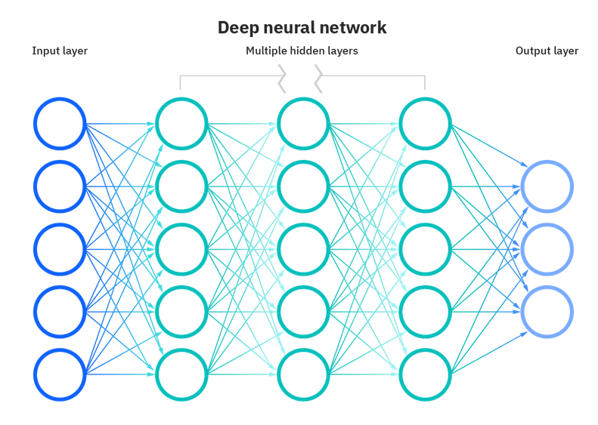
Neural Networks are a subset of Machine Learning and their structure are inspired by the human brain, mimicking the way that biological neurons signal to one another.

Slide 4
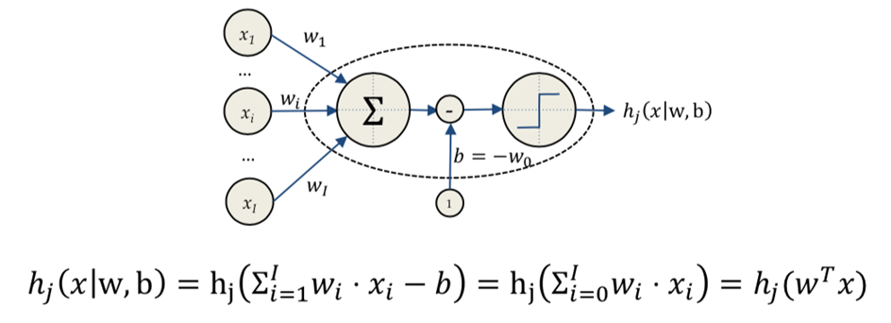
Neural Network is composed of layers, which can be divided into cells (neurons). If we zoom on one, we can notice that a neuron is actually a linear regression of all the neurons in the previous layer.

Slide 5
A neural network has to be trained to be efficient and significant.
During the training, we minimize a defined loss function in order to obtain the parameters.
In our problem ,we use a recurrent neural network (RNN).
RNN works on the principle of saving the output of a particular layer and feeding this back to the input in order to predict the output of the layer.
How it works

Slide 6
The learning rate is a tuning parameter in an optimization algorithm that determines the step size at each iteration while moving toward a minimum of a loss function
An epoch means training the neural network with all the training data for one cycle
Trade Off

Slide 7



Runge Kutta method
To solve second order ODE the method is:
where
The matrix A is called RK matrix, b and c are the weights and nodes.

Slide 8
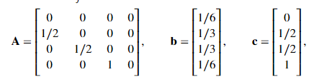
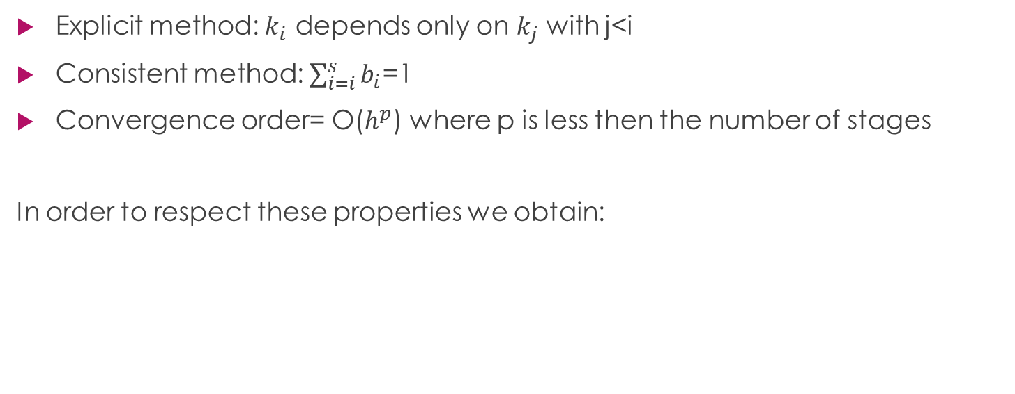
Quick overview of the method
Explicit method: $k_{i}$ depends only on $k_{j}$ with j<i
Consistent method: $\sum_{i=i}^{s}{b_{i}}$=1
Convergence order= O($h^{p}$) where p is less then the number of stages
In order to respect these properties we obtain:

Slide 9
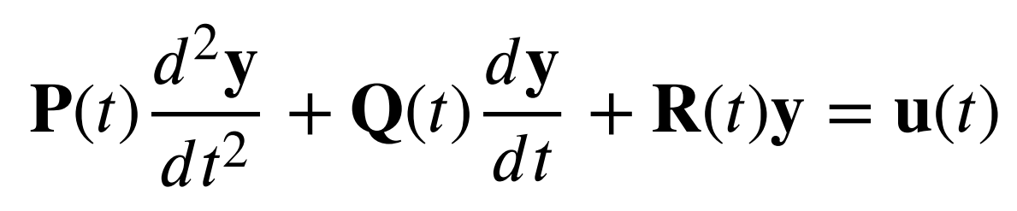
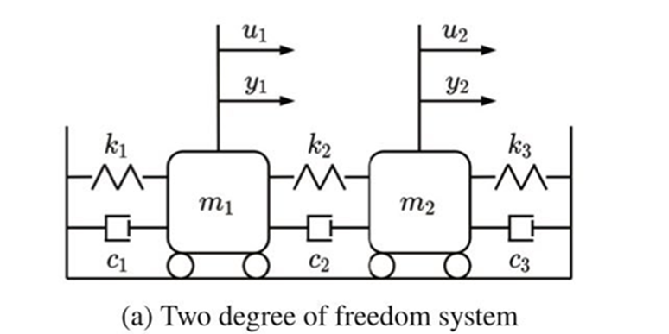
Masses problem
Model parameter identification of a dynamic two-degree-of-freedom system through Runge–Kutta integration.
We consider the motion for two masses linked together springs and dashpots
We assume that while the masses and spring coefficients are known, the damping coefficients are not: we want to extimate them

Slide 10
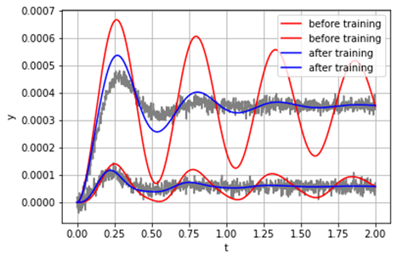
Our strategy
h=0,002
Output = [115.1 71.6 16.7]
We choose the neural network parameters (in the example were given)
We test the convergence of the runge kutta method with different time steps
We try to add a gaussian noise with different std in different time intervals

Slide 11
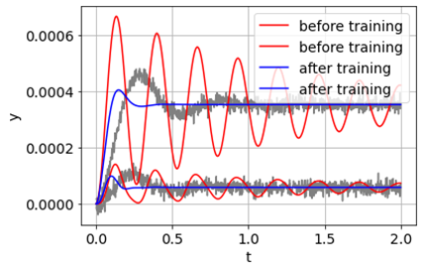
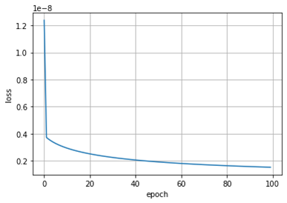
Different time step of RK
We notice that we can’t use a bigger time step, because the output value is really bad
h = 0,004
Output= [180.62221 ,
102.55373 ,
21.072803]

Slide 12
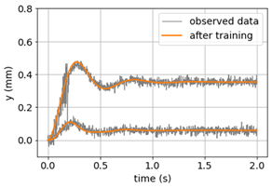
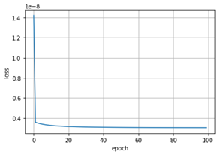
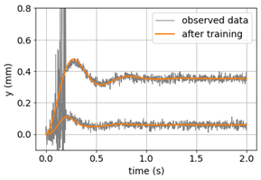
Gaussian noise
time interval [0,0.2]
std=5
std=100
Output:
[117.79279 ,
72.11025 ,
17.402443]
Output:
[109.87381 ,
72.30827 ,
14.474802]

Slide 13
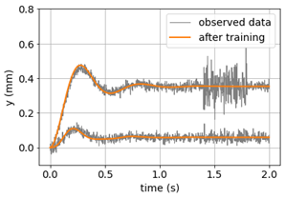
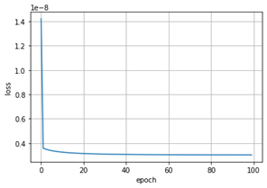
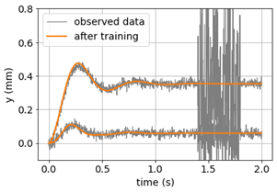
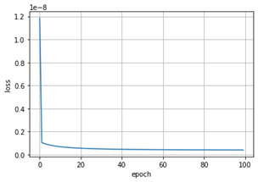
Gaussian noise
time interval [1.4,1.7]
std=5
std=100
Output:
[115.152145,
71.78918 ,
16.636393]
Output:
[114.94353 ,
72.04542 ,
16.565477]

Slide 14
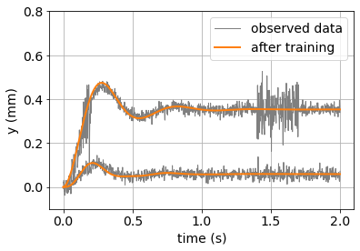
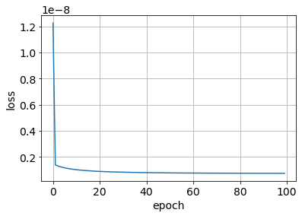
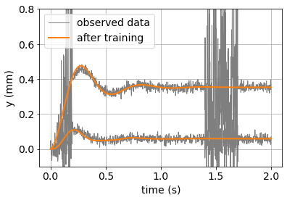
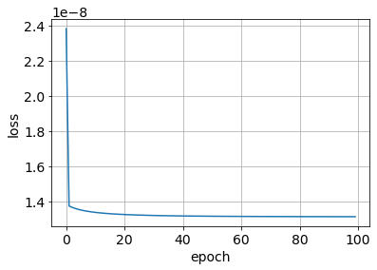
Gaussian noise
time interval [0,0.2] U [1.4,1.7]
std=5
std=100
Output:
[117.8953 ,
72.30025,
17.36585]
Output:
[109.54126 ,
73.11582 ,
14.2527895]

Slide 15
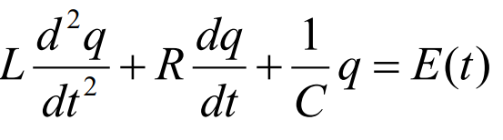
RLC circuit
Goal: estimate the parameter R, resistance
Input: measurement of the tension
Output: measurement of the charge on the capcitor

Slide 16
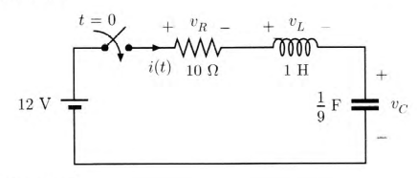
RLC circuit, constant V

Slide 17
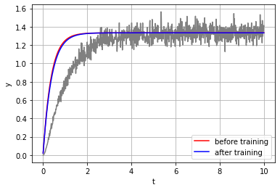
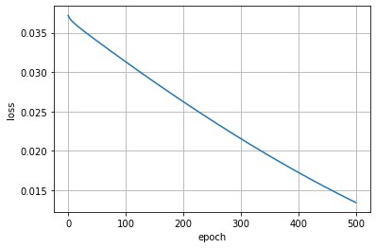
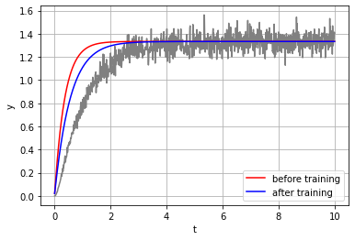
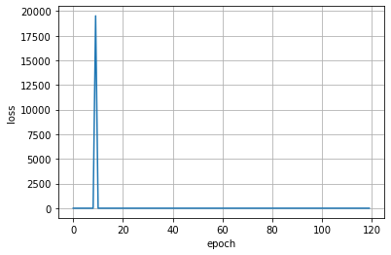
Issuses with learning rate and epochs
Learning rate=0.01
Epochs=500
Too small: the NN learns slowly
Learning rate= 1
Epochs=120
Too big: the NN doesn’t
converge

Slide 18
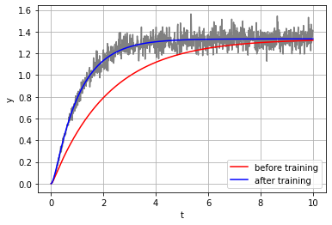
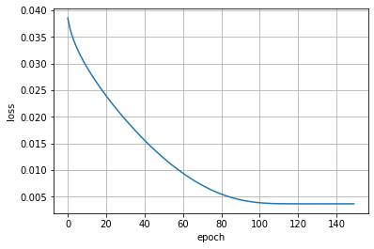
Optimal choice for NN
Learning rate= 0.1
Epochs= 120
Output= [9.985753]

Slide 19
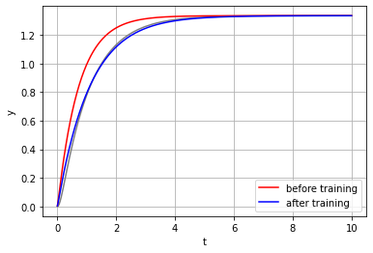
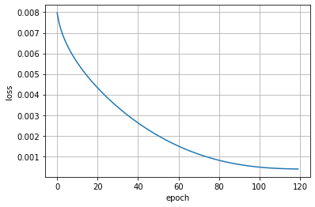
Limit of RK time step
We find the maximum step using the data without noise, the exact values.
h=0.006

Slide 20

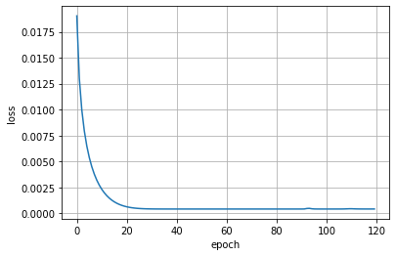
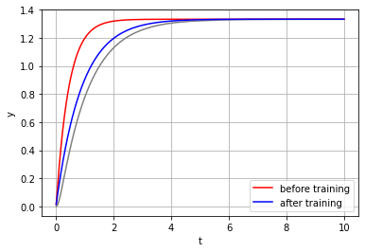
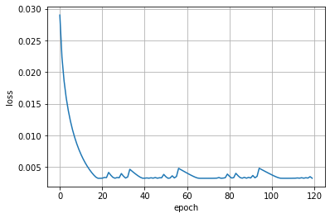
Limit RK time step
h= 0.008
h= 0.010

Slide 21
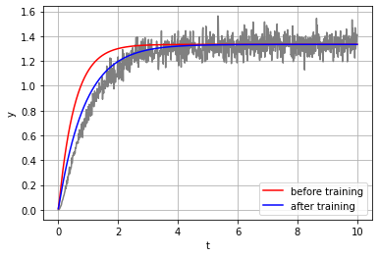
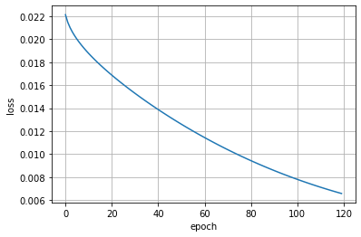
Theorecitlca vs Real
The theoretical limit is with h=0.08 but with the same h and the observed data we obtain
Output=[31.9423]
The estimation still bad with smaller h, it is good only with the minimum step (h=0.002).

Slide 22
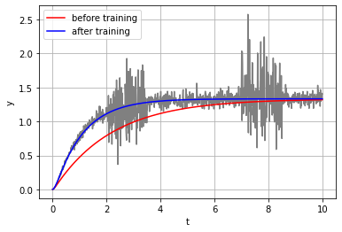
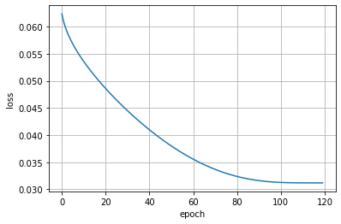
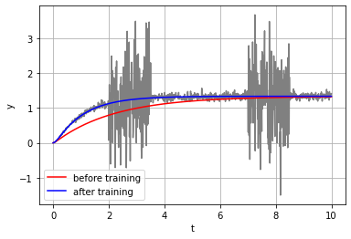
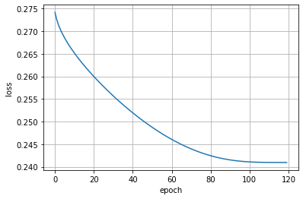
Noise
T=[2,3.5]U[7,8.5]
Std=50
Output=[10.420536]
T=[2,3.5]U[7,8.5]
Std=100
Output=[10.189874]

Slide 23
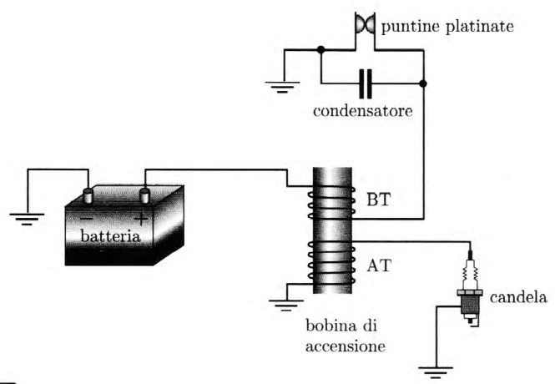
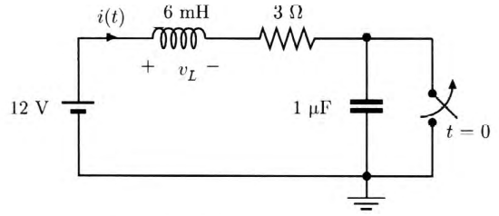
APPLICATION
IGNITION CIRCUIT FOR A GASOLINE-POWERED ENGINE
→

Slide 24
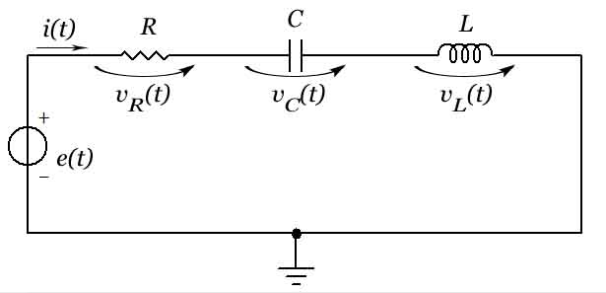
RLC circuit, sinusoidal input

Slide 25
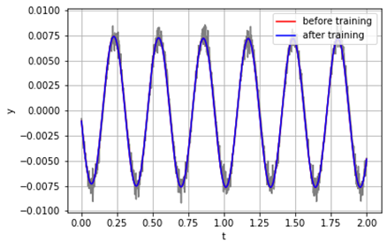
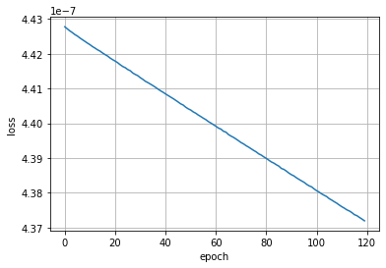
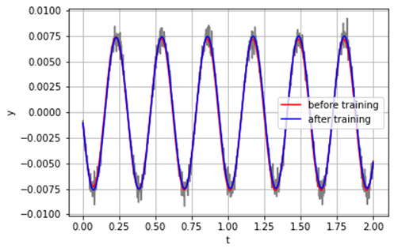
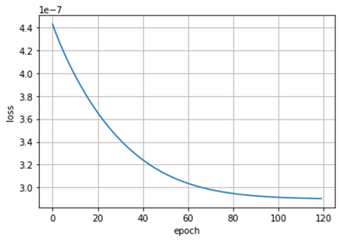
Neural Network parameters
Learning rate= 0.01
Epochs= 120
Learning rate= 1
Epochs= 120

Slide 26
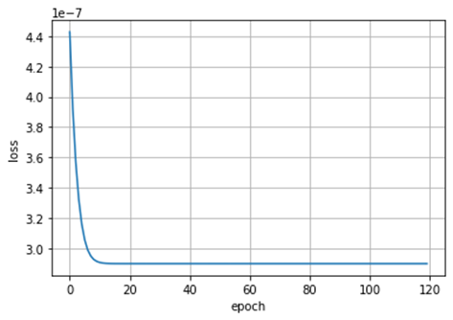
Neural Network parameters
Learning rate= 10
Epochs= 120
Output=[18.725863]
Perfect example of trade off:
We choosed as learning rate 10
Because we prefered using less epoch (100) over a more sensitive output
From now on we will use (10,100)
Learning rate= 1
Epochs= 120
Output=[18.769863]

Slide 27
Different time step of RK
h = 0.004
The RK method does not converge for a bigger time step
Also in this case to find the biggest time step, we used the data without noise

Slide 28
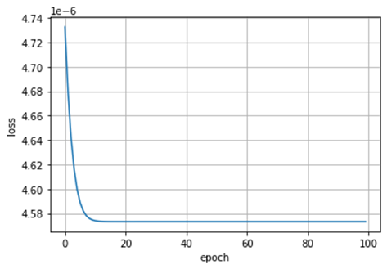
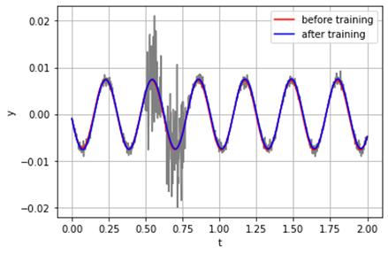
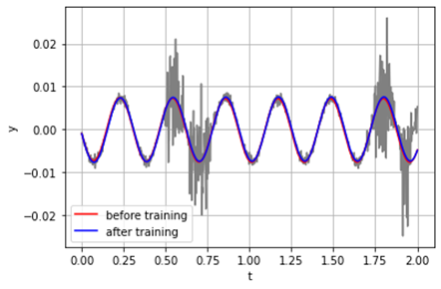

Gaussian Noise
Time interval=[0.5,0.8]
Std=100
Output=[18.589947]
Time interval=[0.5,0.8]U[1.7,1.9]
Std=100
Output=[17.540703]

Slide 29


RLC sinusoidal with more input
We tried to see what happen if we use as an input the sum of some sine waves
2 inputs:
Learning rate=1
Epochs=200
Output=[17.065903]
This is the best output that we found, and it’s quite acceptable

Slide 30




RLC sinusoidal with 3 inputs
Learning rate= 0.01
Epochs=5000
Learning rate=0.1
Epochs=5000

Slide 31
Conclusion
Data with a big noise are not a problem.
The step for RK isn’t flexible.
The model doesn’t work well for irregular input

